Slide 1
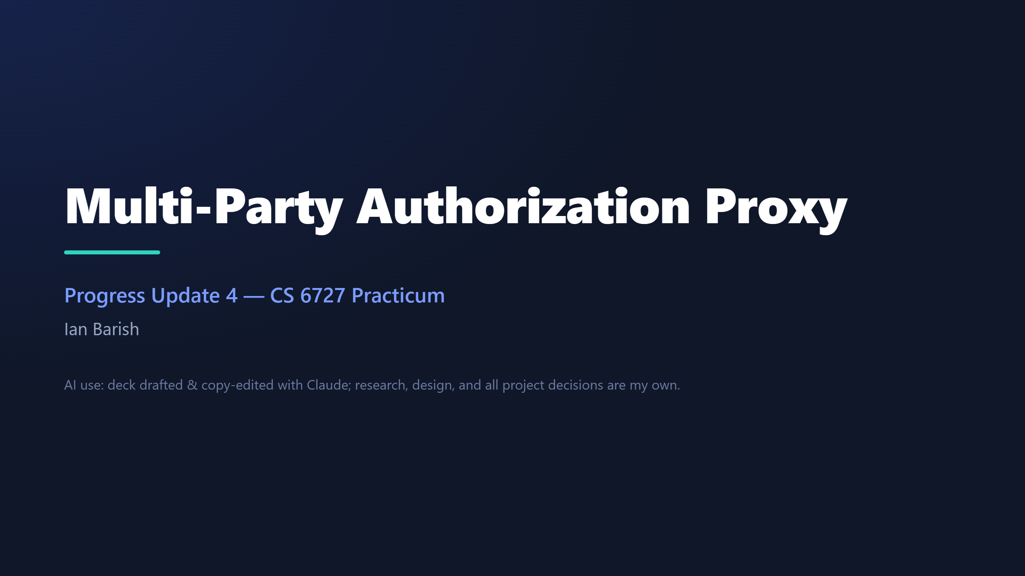
Notes:
SCRIPT (~10s): • "Hi — this is my fourth progress update on the multi-party authorization proxy." • "Last cycle I built the thing; this cycle I set out to prove it's sound." One sentence, then move on — a long intro is the exact thing the TA flagged.

Slide 2
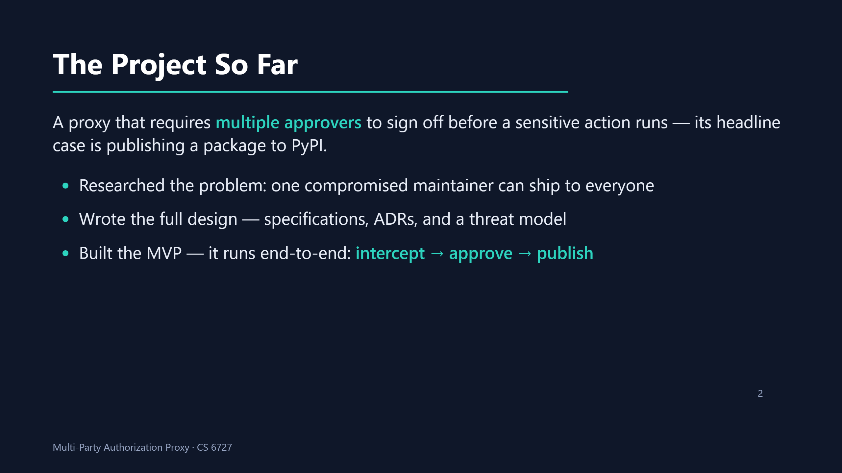
Notes:
SCRIPT (~30s, HARD CAP — the intro is what got flagged, keep it tight): • "Quick recap for anyone who missed a video: this is a proxy that makes several people approve a sensitive action before it runs, and the headline case is publishing a package to PyPI." • "First cycle was research — I showed how one compromised maintainer can ship malicious code to everyone downstream." • "Second was the full written design — specs, ADRs, and a threat model." • "Third, I built it: the MVP now runs end-to-end — it intercepts the upload, collects a quorum of approvals, then publishes." • Don't retell the story — just set the baseline so this cycle lands.

Slide 3
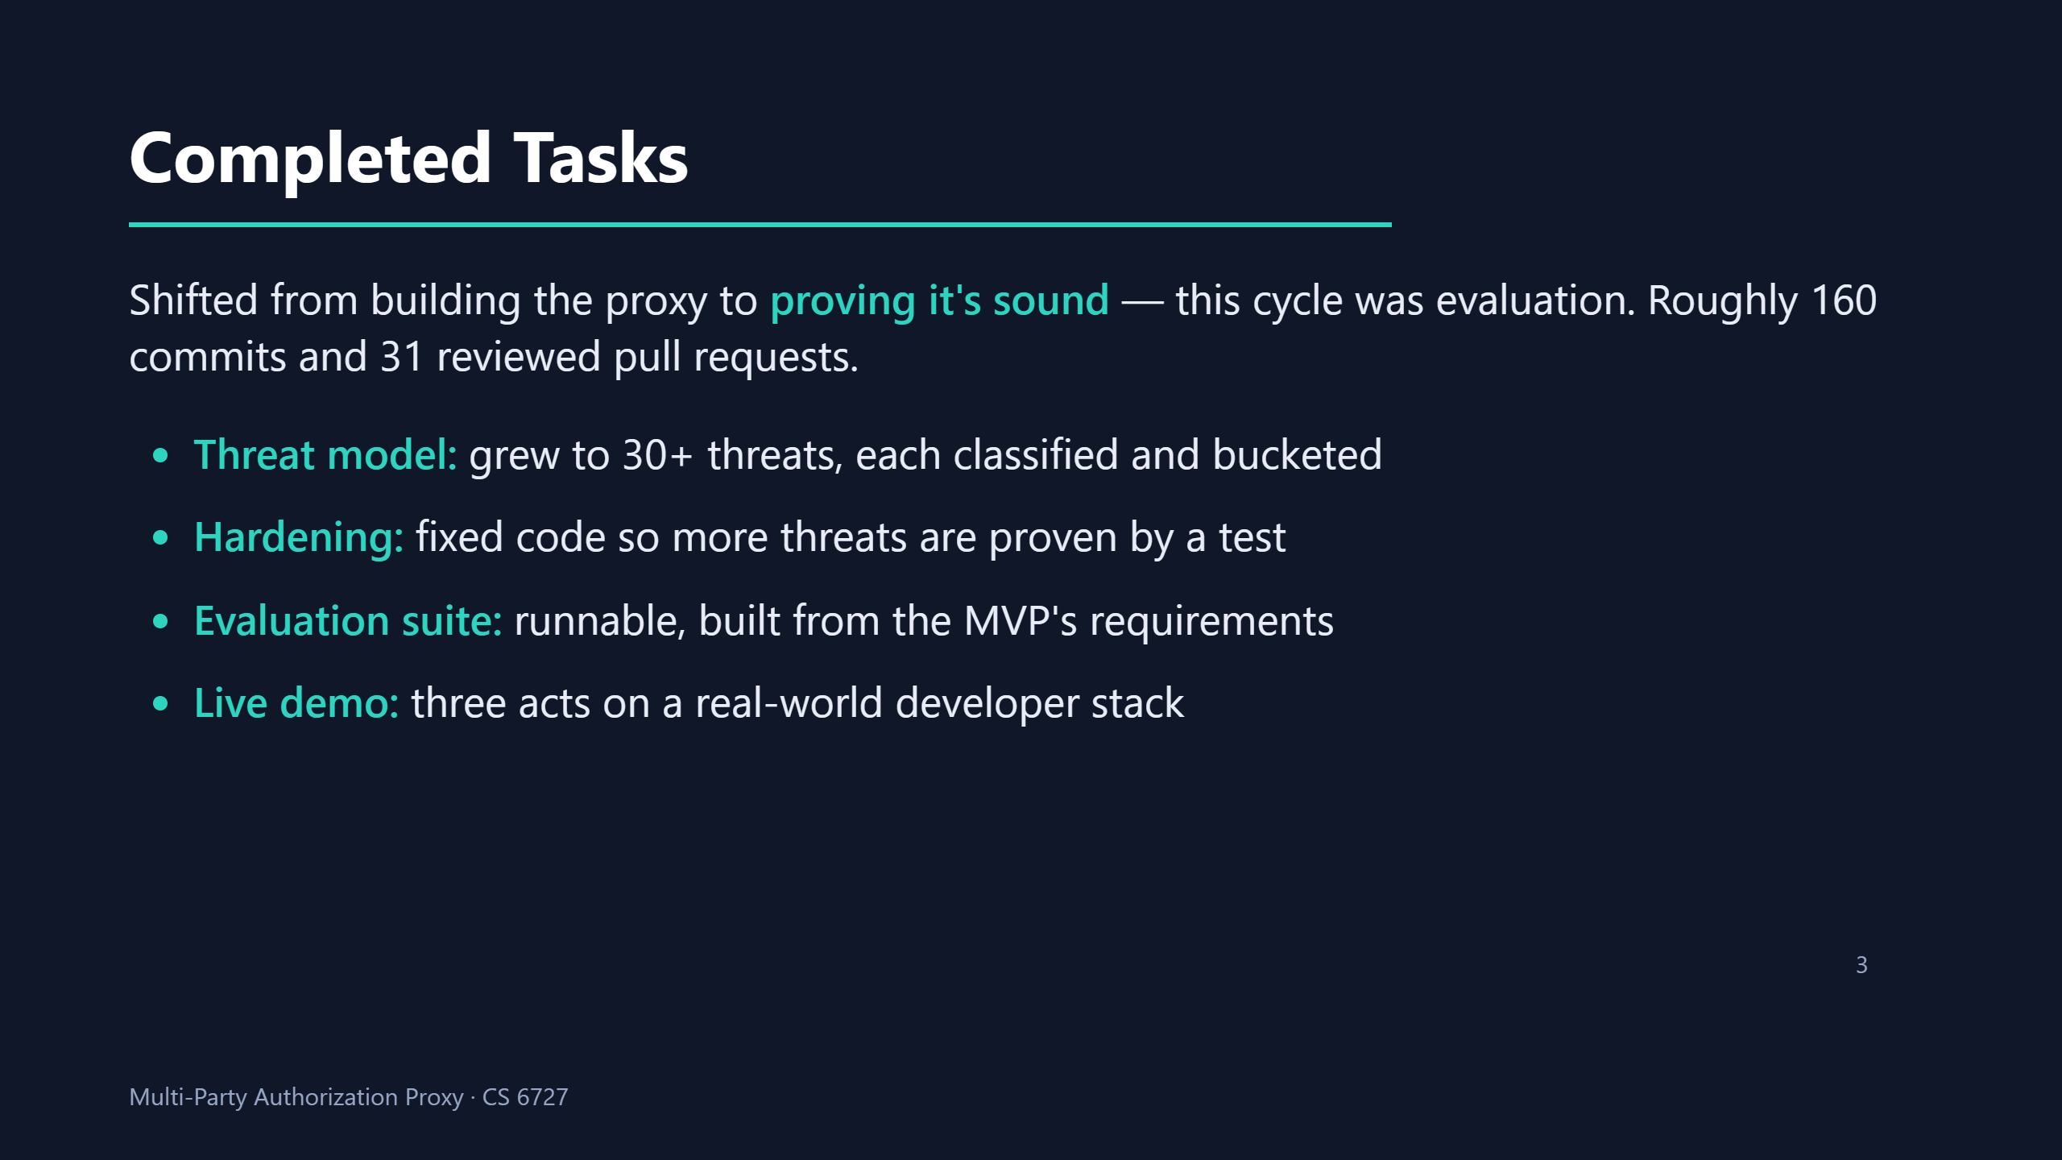
Notes:
SCRIPT (~90s — the substance, spend the time here): • "This cycle I shifted from building the proxy to proving it's sound — the whole cycle was about evaluation. It came to roughly 160 commits across 31 reviewed pull requests." • "First, the threat model. I grew it to over thirty threats, and for each one I answer two questions — I'll show that on the next slide — then tag it and sort it into a bucket." • "Second, hardening. Where a threat wasn't actually defended in the code, I fixed the code, so more threats moved into the strongest bucket — the ones I can prove with a passing test rather than just argue." • "Third, I turned that into a runnable evaluation suite, built straight from the requirements the MVP had to meet — so 'does it work' is something I run, not something I claim." • "And fourth, a three-act live demo that stands up the whole stack the way a real developer environment looks, so I can show the flow end-to-end in the final presentation."

Slide 4
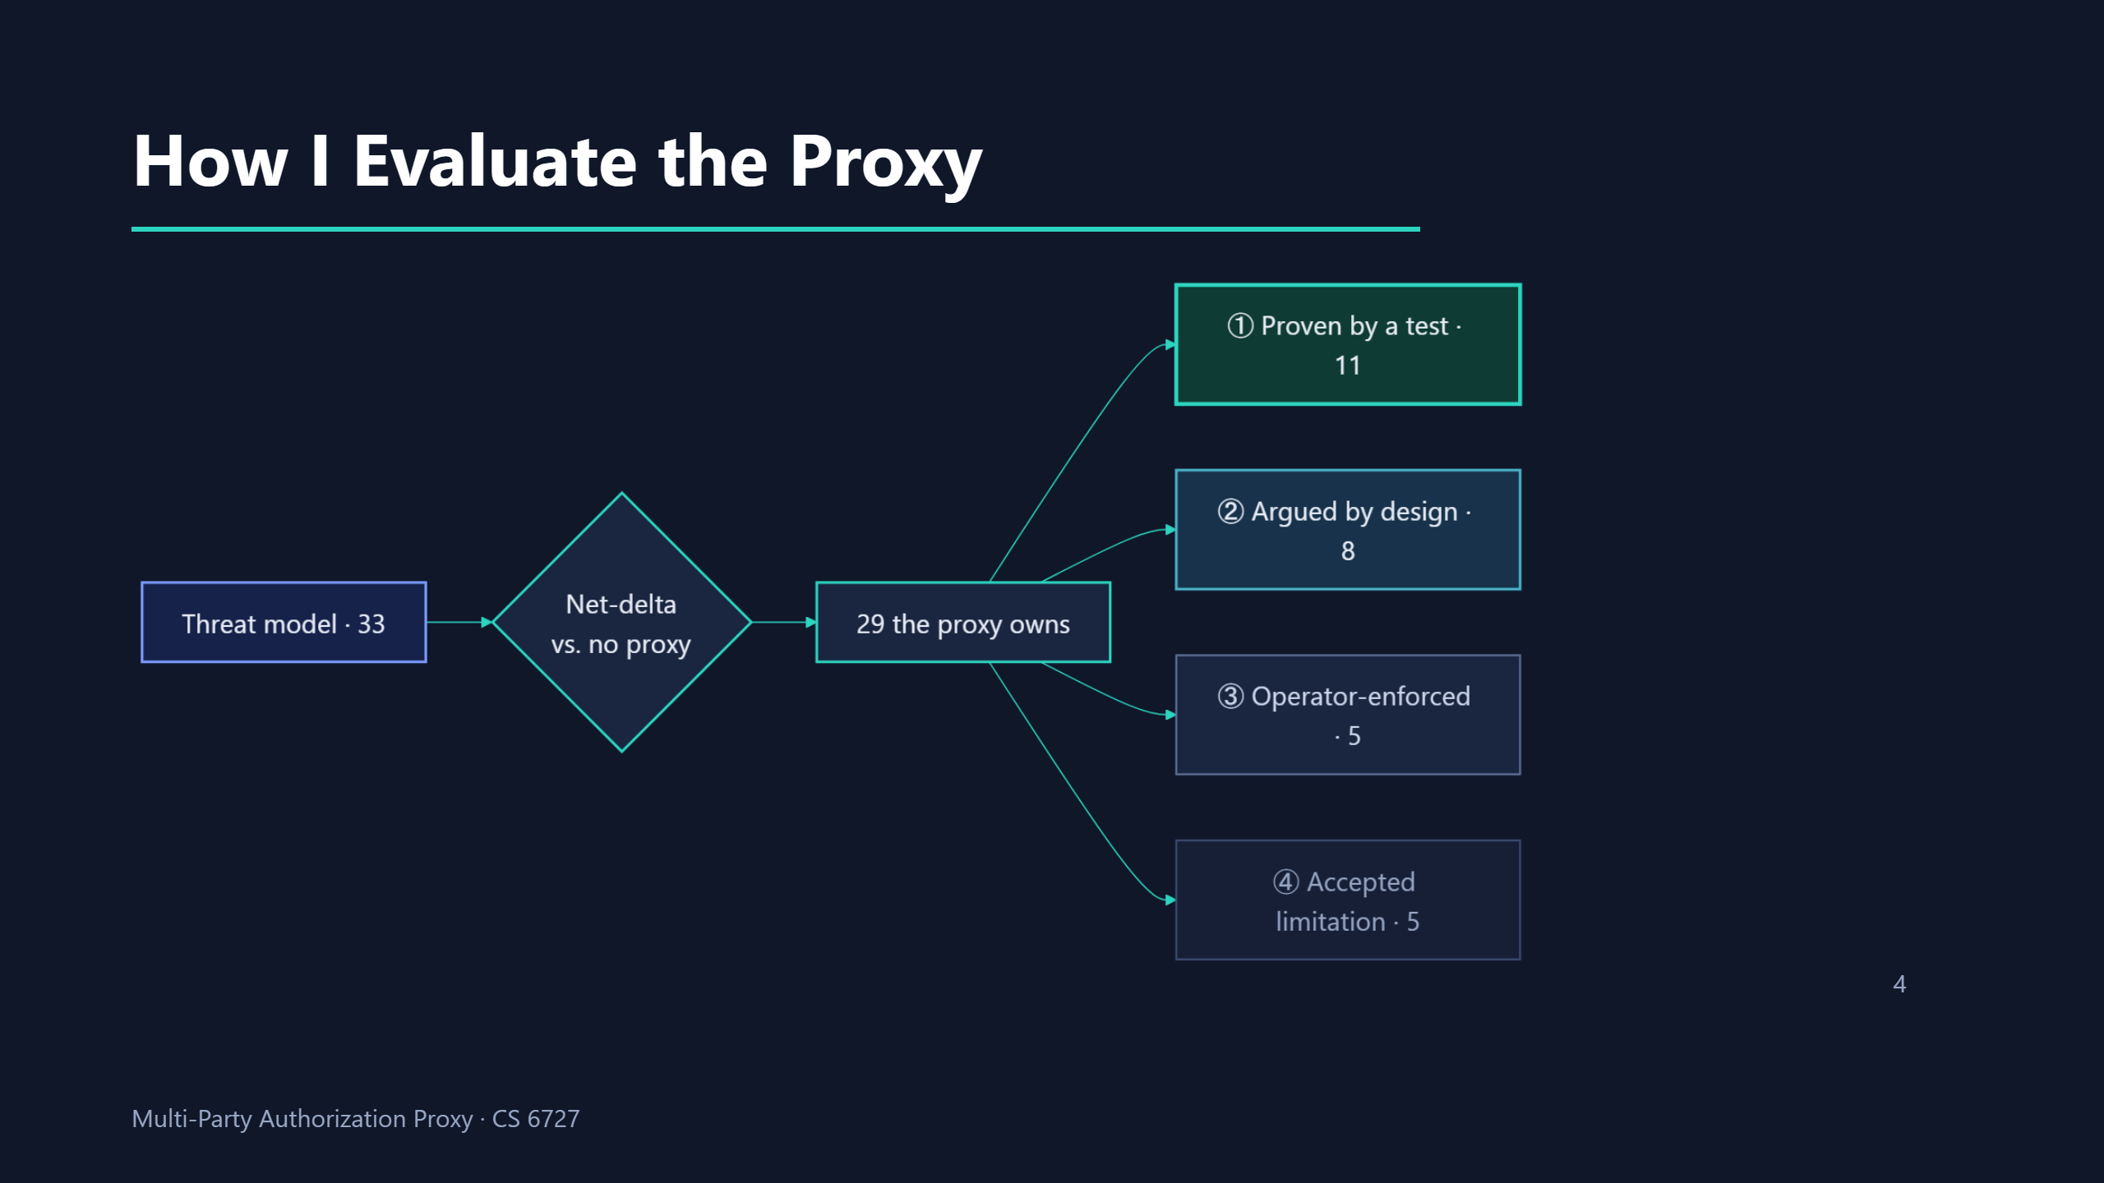
Notes:
SCRIPT (~25s): walk it left to right, one continuous sentence. • "Here's the method. I start with the full threat model — thirty-three threats. For each one I ask a net-delta question: compared to publishing with NO proxy, does the proxy make this threat better, leave it unchanged, or introduce it? The twenty-nine the proxy actually owns then get sorted into four buckets by how strongly I defend each — from 'proven by a test' at the top down to 'accepted limitation' at the bottom. That spread IS the security result."

Slide 5
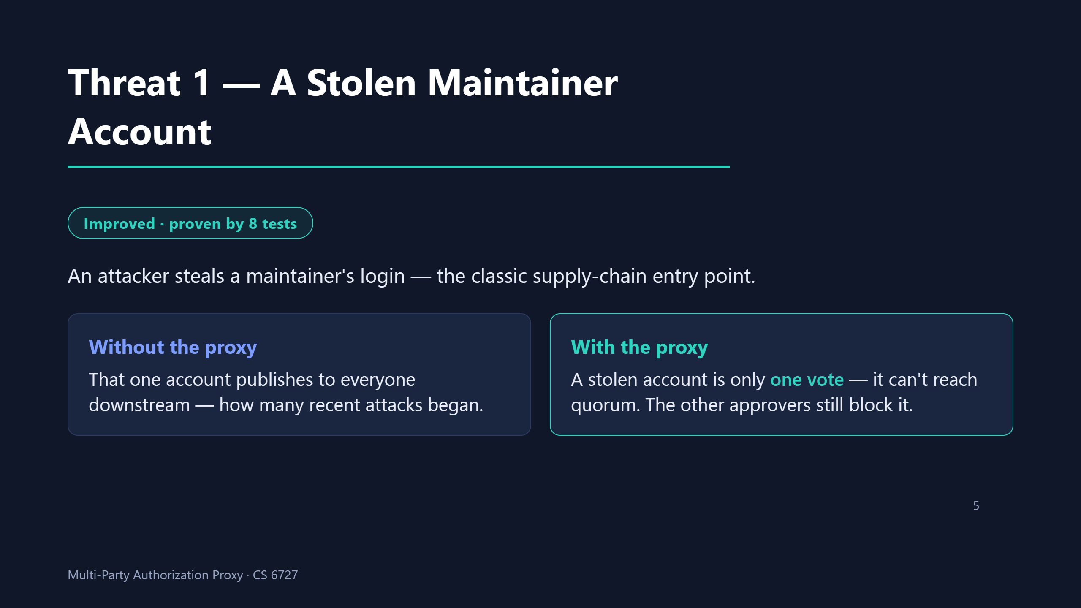
Notes:
SCRIPT (~30s): • "To make that concrete, three example threats — starting with the one the whole project exists to fix." • "An attacker steals a maintainer's login — a stolen token, a phished password. That's how a lot of recent supply-chain attacks start." • "Publishing directly, that one account ships malicious code to everyone who depends on the package." • "Behind the proxy, that same stolen account is worth exactly one vote — it can't reach quorum on its own, so the other approvers still stand in the way. I prove that with eight tests, including the worst case where all but one seat is fully compromised." • The key line: "the proxy doesn't make theft less likely — it makes it matter less."

Slide 6
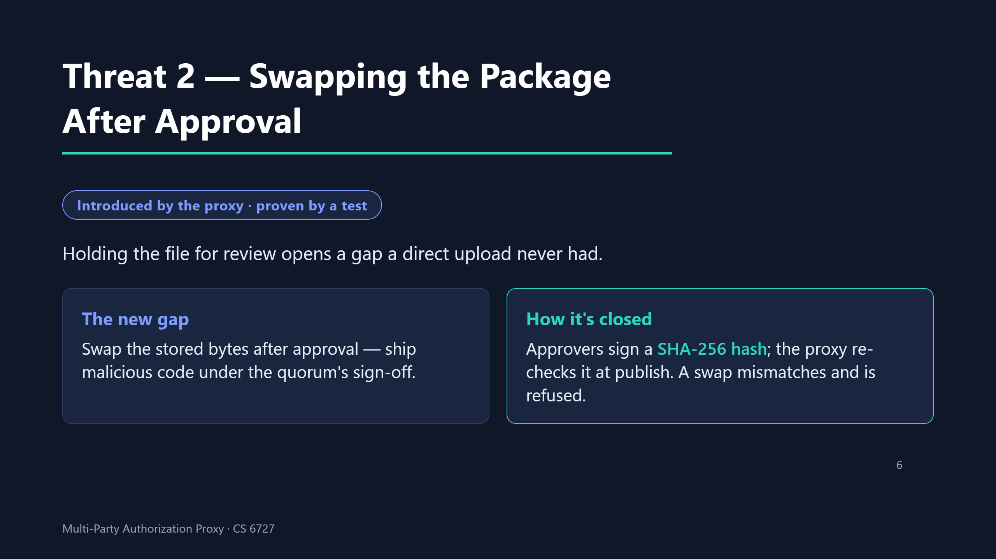
Notes:
SCRIPT (~30s): • "Second threat — and this one's honest: the proxy INTRODUCES it. My model doesn't just count the threats I fix, it counts the ones I create." • "Because the proxy holds the file while people review it, there's a window between upload and publish that a plain upload never has. If someone swaps the stored bytes after approval, malicious code ships wearing the quorum's sign-off." • "I close it by binding to the content: approvers approve a specific SHA-256 hash, and the proxy re-computes and re-checks that hash the instant before it publishes. Swapped bytes don't match, and publication is refused — proven by tests."

Slide 7
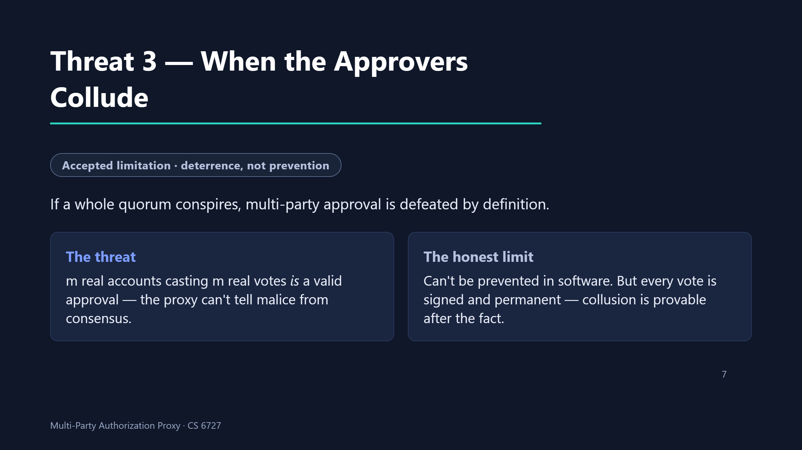
Notes:
SCRIPT (~30s): • "Third threat — and here I have to be honest about a limit. If a full quorum colludes, multi-party approval is defeated by definition." • "m genuine accounts casting m genuine votes IS a valid approval — there's no signal inside the proxy that tells corrupt consensus apart from real consensus." • "So I don't claim to prevent it. What the proxy does is raise the price: every vote is cryptographically signed and permanent, so collusion goes from one quiet defector to m people who each leave provable evidence." • "I'd rather state a limit like this plainly than paper over it — and that honesty is exactly what the net-delta model is for."

Slide 8
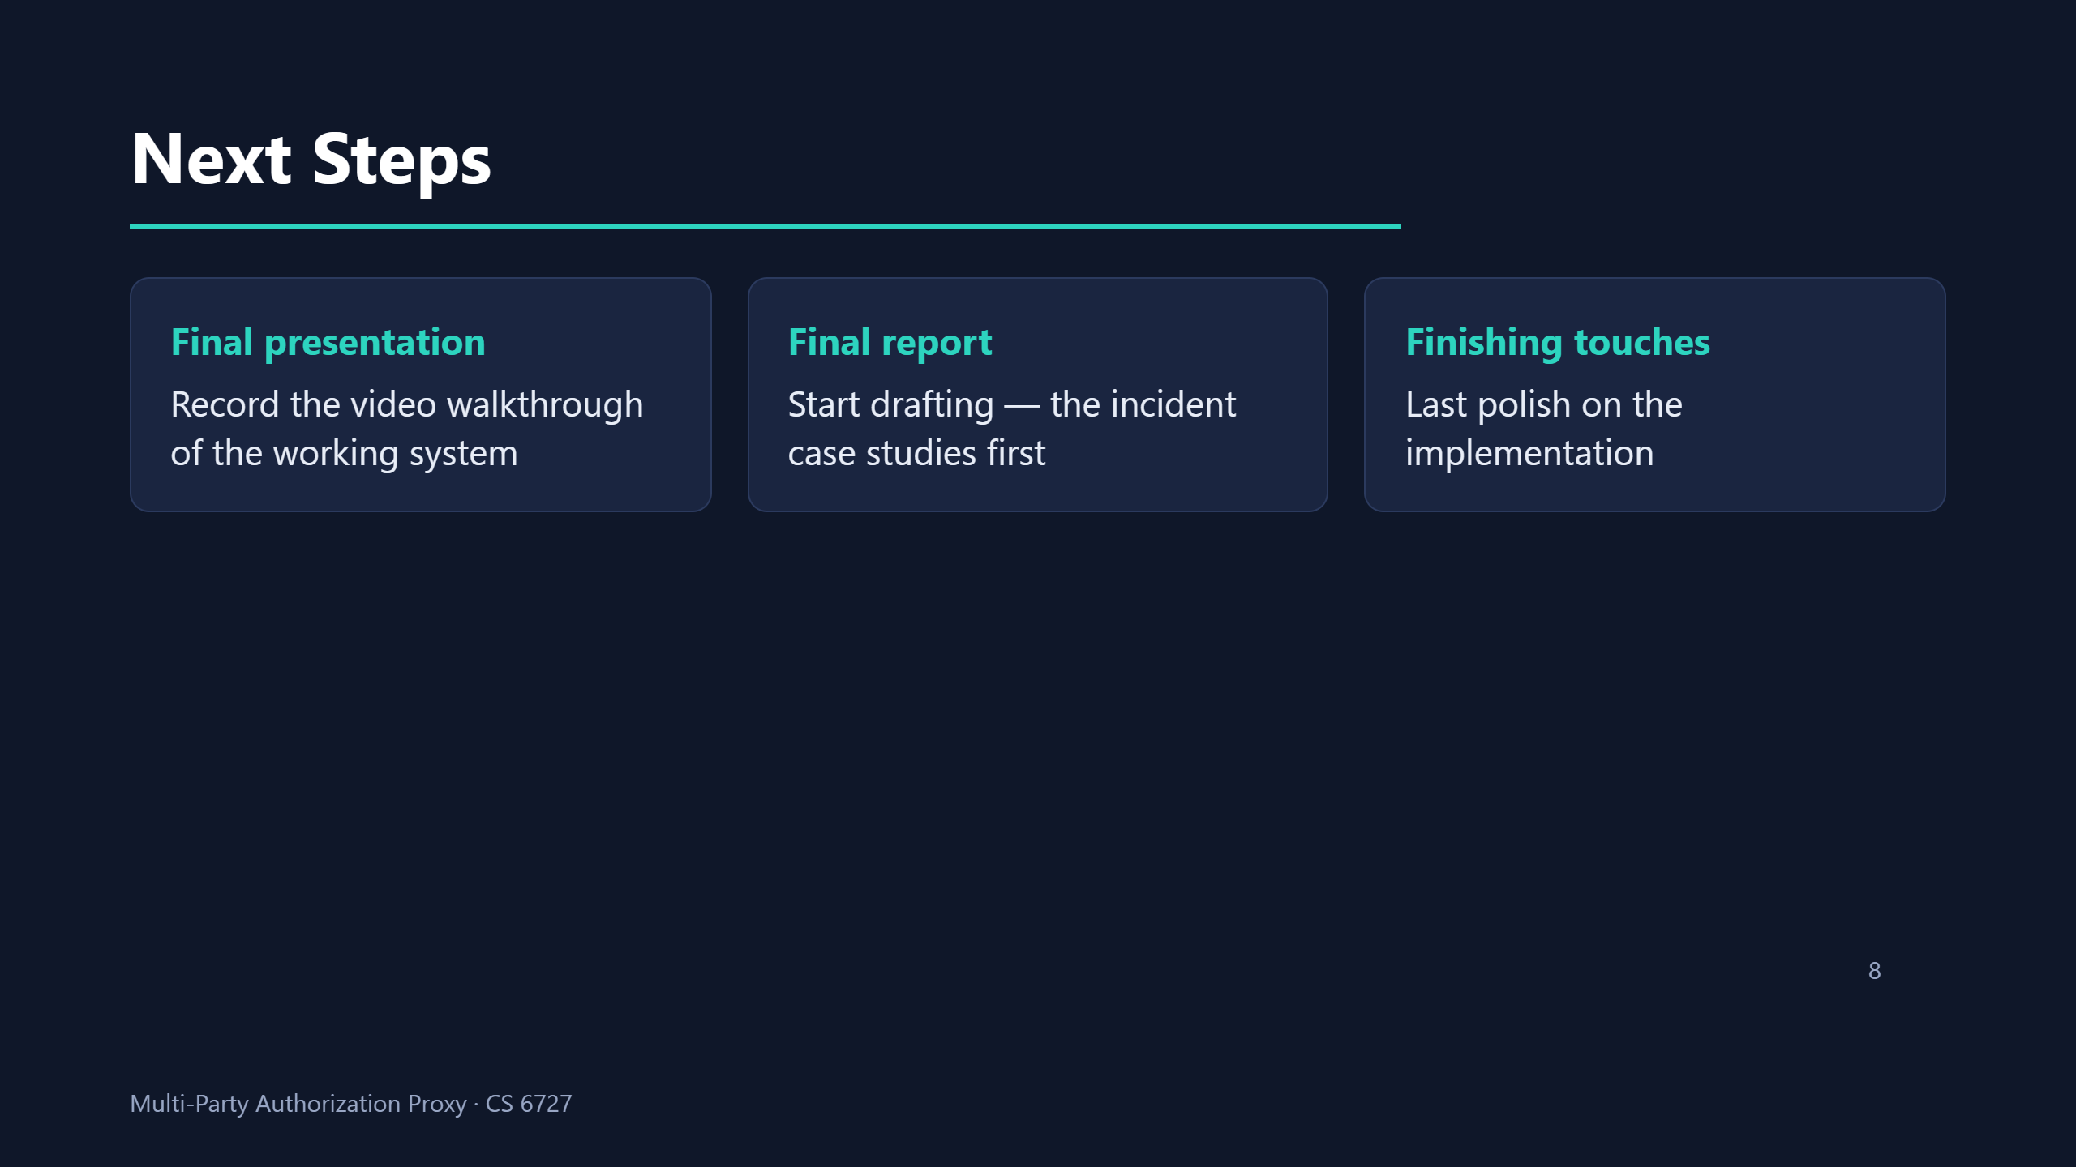
Notes:
SCRIPT (~60s): • "Next steps. First, the final presentation — I'll record a full walkthrough of the working system now that the demo stack is ready." • "Second, I start writing the final report. I'm beginning with the incident case studies — the real supply-chain compromises that motivate the whole project — because those are the most self-contained to write and they anchor everything after them. Goal is a rough draft by the next report." • "Third, a last round of finishing touches on the implementation as I write it up and spot rough edges."

Slide 9
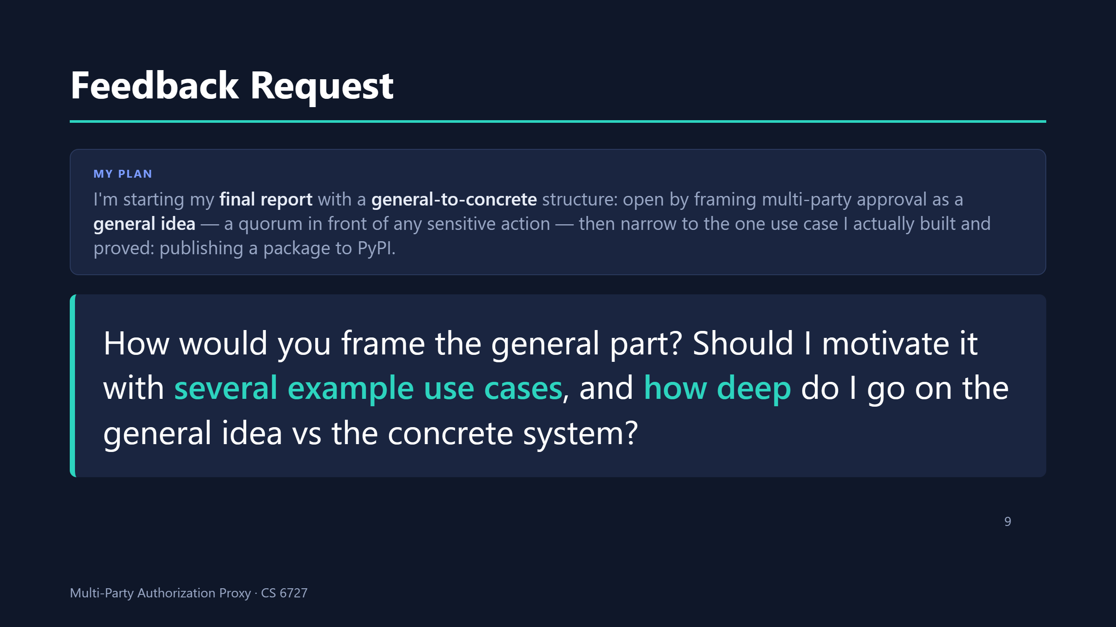
Notes:
SCRIPT (~40s): the video ENDS here — protected slot, do not rush. • "Last thing — a question for the group as I start my final report." • "My plan is a general-to-concrete structure. I open by framing the core idea in general terms — putting a quorum of approvers in front of ANY sensitive action, not just publishing. Then I narrow down to the one use case I actually built and evaluated: publishing a package to PyPI." • "What I'd love input on is that opening. How would you frame the general part? Is it worth sketching several example use cases to motivate it — CI deploys, infrastructure changes, that kind of thing — or does that dilute the focus?" • "And how deep would you go on the general idea vs the one concrete system I can actually prove? That's the balance I'm trying to strike."

